Slide 1
HOUSE RENT APP USING MERN
TEAM MEMBERS
SHARMILA.A
SOWMIYA.B
SUBHASHREE.P
SRI LAKSHMI PRABHA.M

Slide 2
TABLE OF CONTENTS
ABSTRACT
INTRODUCTION
PROPOSED SYSTEM
BLOCK DIAGRAM
MODEL SCREENSHOT
CONCLUSION

Slide 3
ABSTRACT
This project focuses on the development of a House Rent Application using the MERN stack (MongoDB, Express.js, React.js, Node.js). The application facilitates the process of finding and renting properties like houses, apartments, and rooms. It includes features such as property listings, search filters, landlord-tenant communication, and booking confirmations. The application aims to streamline the rental process by providing users with a user-friendly interface to explore and manage rental properties.

Slide 4
INTRODUCTION
A house rent app is a web-based platform designed to help users search for rental properties efficiently. The MERN stack is used for developing the application, which ensures real-time communication and fast processing. Users can browse through various property listings, apply filters to refine their search, contact property owners or managers, and submit rental inquiries. This platform also allows property owners to list their properties and manage bookings, ensuring an end-to-end solution for the rental process.

Slide 5
PROPOSED SYSTEM
The proposed system allows both tenants and landlords to interact on a single platform.
Tenants can:
Register and browse available rental properties.
Apply filters based on location, rent range, property type, and more.
Submit booking inquiries and view confirmations.
Landlords can:
Register and list their properties.
Manage property details and availability.
Respond to tenant inquiries and approve bookings.

Slide 6
IMPLEMENTATION: MERN STACK
FRONTEND
React.js:
Used to build a dynamic, responsive user interface.
Displays property listings, search filters, and booking forms.
Utilizes component-based architecture for modular and reusable UI elements.

Slide 7
BACKEND
MongoDB:
NoSQL database for storing user information, property listings, and rental transactions.
Express.js:
Handles API requests, user authentication, and property management logic.
Node.js:
Runtime environment for executing server-side JavaScript, managing backend operations and data flow between the front-end and MongoDB.

Slide 8
INTEGRATION
MONGODB
PRISMA
EXPRESS API
Request
Response
REACT APP

Slide 9
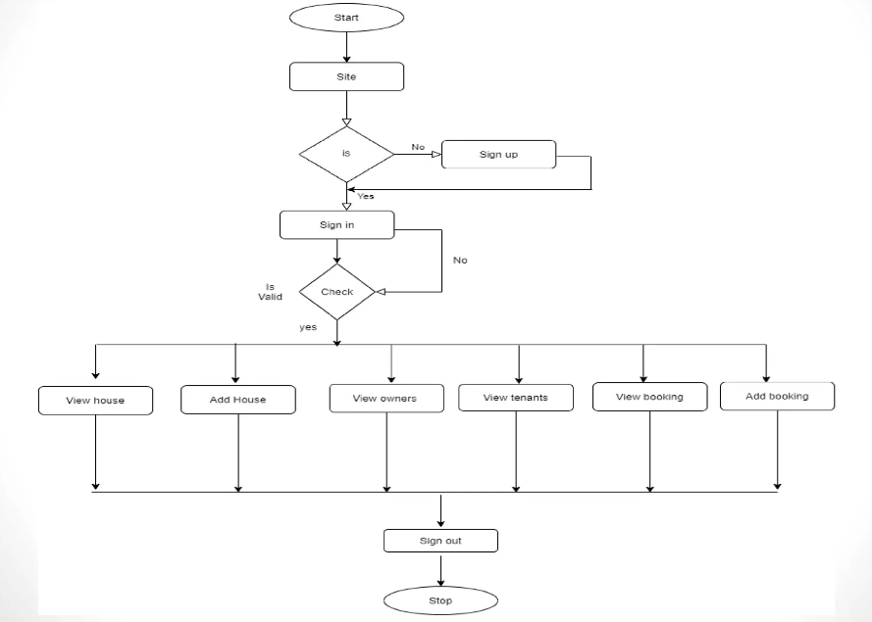
BLOCK DIAGRAM

Slide 10
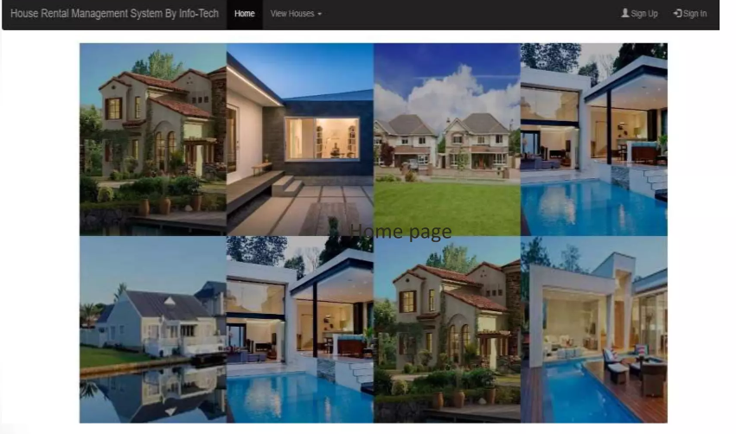
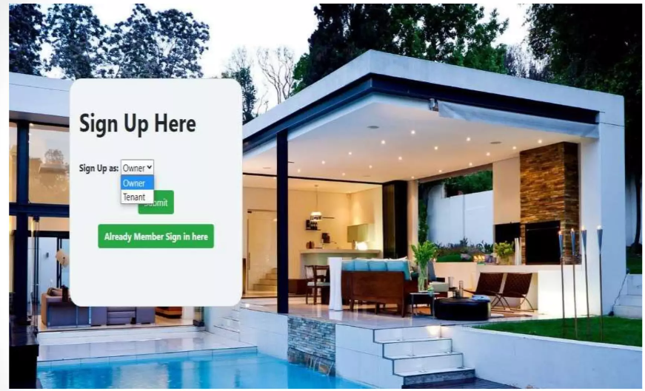
MODEL SCREENSHOT

Slide 11
CONCLUSION
The House Rent App using MERN provides a complete solution for managing rental properties and transactions. The platform enables efficient communication between landlords and tenants, simplifies the rental process, and ensures transparency and security in all transactions. By leveraging the power of the MERN stack, the app ensures real-time data management and an intuitive user experience, making it easier for users to find and rent properties online.

Slide 12
THANK YOU

